Slide 1
Tutorial 5
Bringing Virtual Reality to Android Development
CS551 Advanced Software Engineering
UMKC

Slide 2
Topics
Google Cardboard
Environment Setup for Development

Slide 3
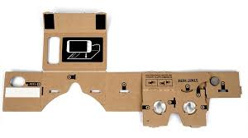
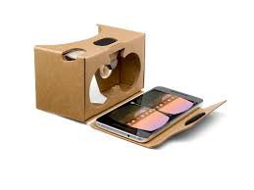
Google Cardboard
Experience virtual reality in a simple, fun, and affordable way.

Slide 4
Environment Setup For Development
Required Software & Tools:
Android Studio 2.2.2 or Higher
Version 25 of Android
Gradle 23.0.1 or higher
Android device running Android 4.4 (KitKat) or higher
Clone the GVR SDK from the gvr-android-sdk GitHub repository by running the following command:
git clone https://github.com/googlevr/gvr-android-sdk.git

Slide 5
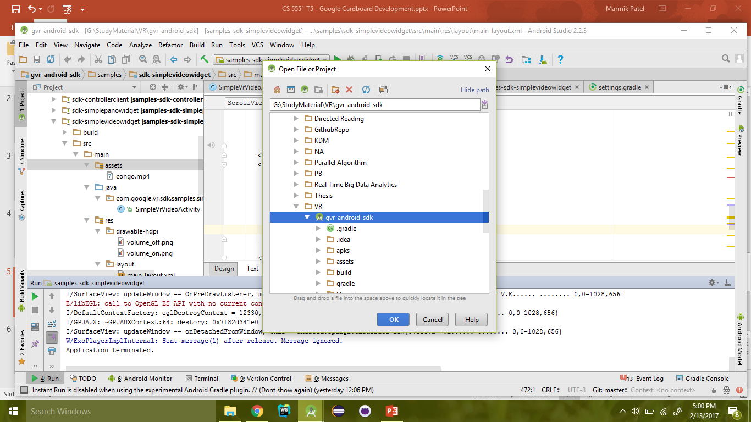
Environment Setup For Development
Open downloaded project in android studio

Slide 6
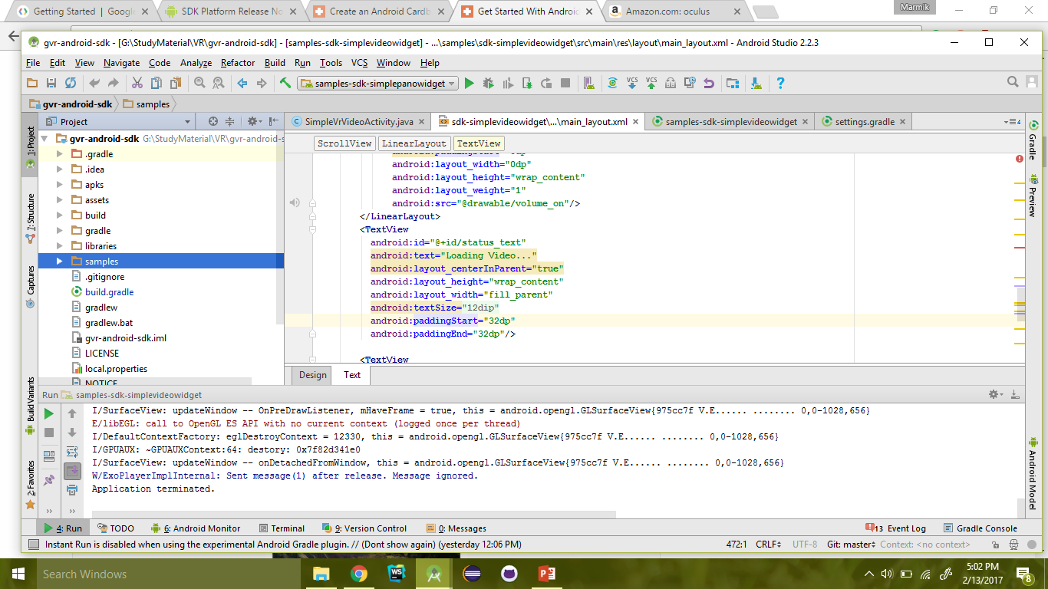
Environment Setup For Development
Now run any of the sample package to build the project

Slide 7
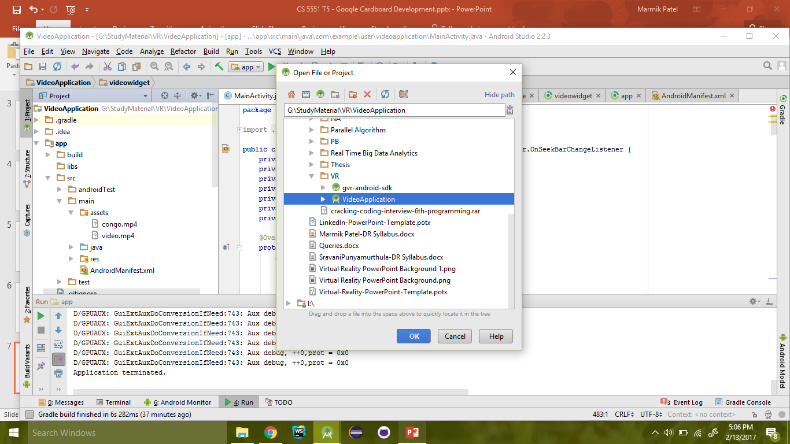
First Cardboard App: 360 Video Viewer
Open the project provided into tutorial

Slide 8
First Cardboard App: 360 Video Viewer
Prepare the basic structure of project:
Create new project in android studio
Set minimum SDK to Android 4.4
Create empty activity
Click “Finish”
Now we have to import necessary packages for creating cardboard application.

Slide 9
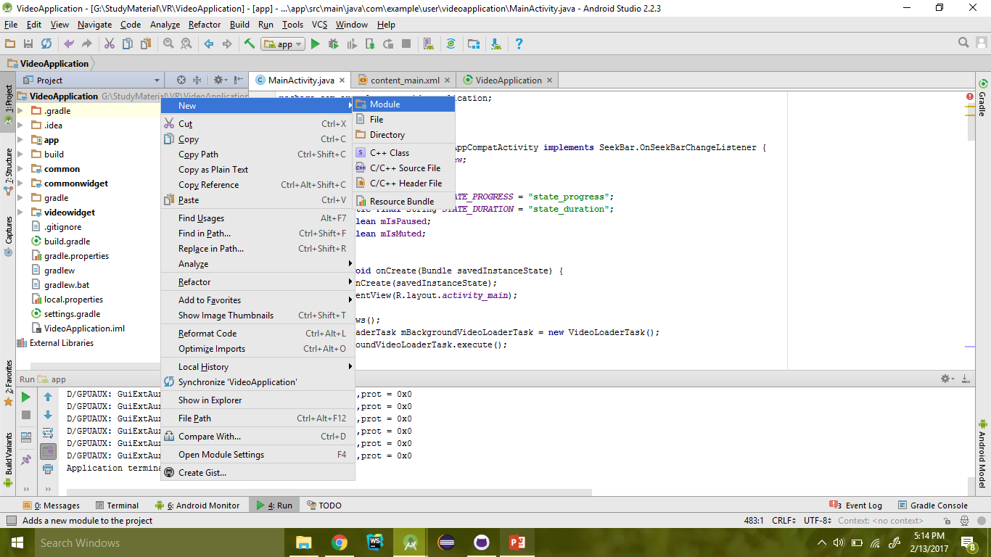
First Cardboard App: 360 Video Viewer
Right click on the project and select create new module

Slide 10
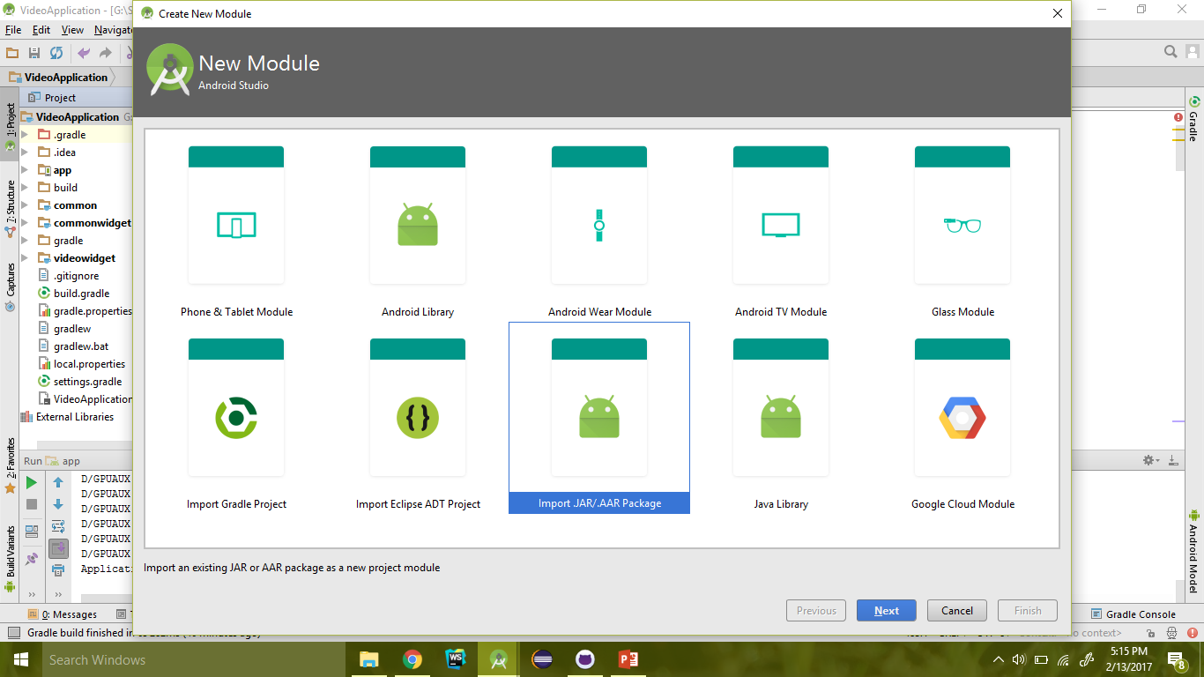
First Cardboard App: 360 Video Viewer
Select import .JAR/.AAR and click Next

Slide 11
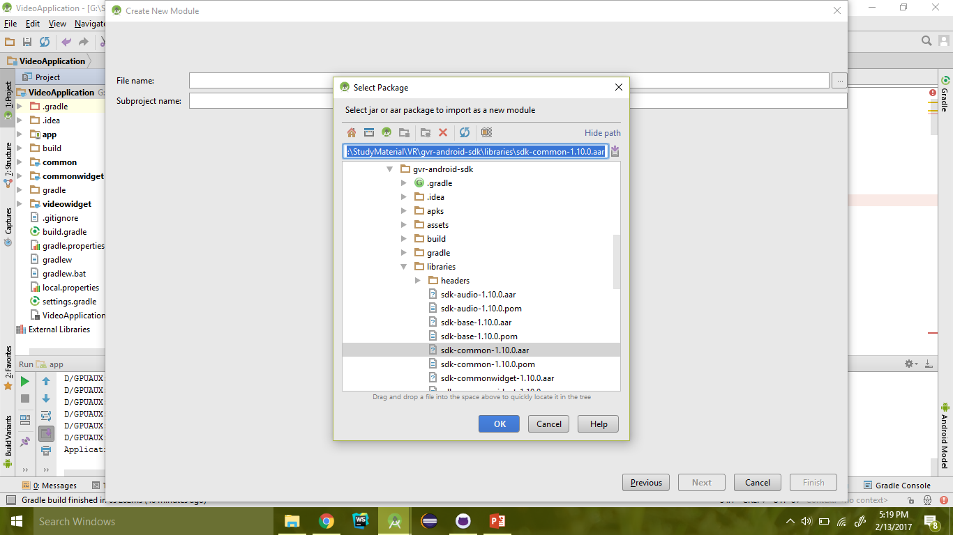
First Cardboard App: 360 Video Viewer
Browse to the root of gvr-android-sdk -> libraries -> select sdk-common-1.10.0.aar

Slide 12
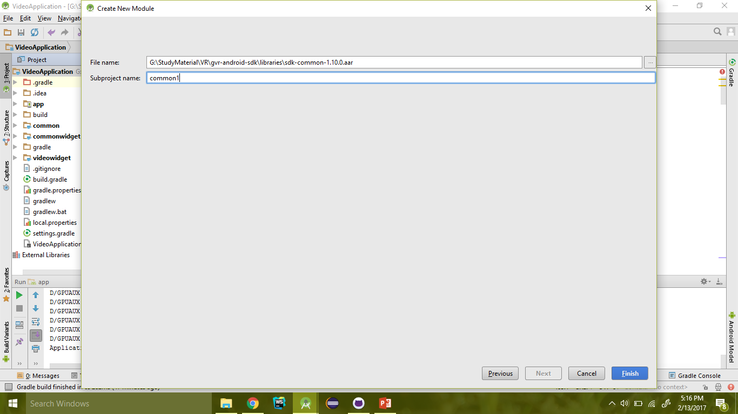
First Cardboard App: 360 Video Viewer
Give name of subproject and select “Finish”

Slide 13
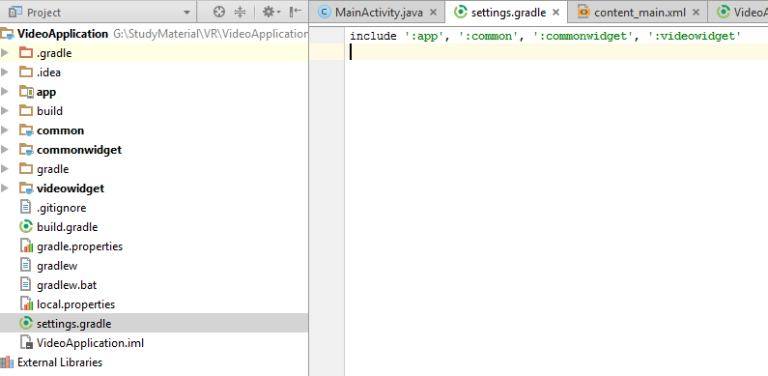
First Cardboard App: 360 Video Viewer
Follow same procedure for two more .aar files
sdk-commonwidget-1.10.0.aar
sdk-videowidget-1.10.0.aar
Now open the settings.gradle file and make following modification
Make sure name is same as shown in project structure

Slide 14
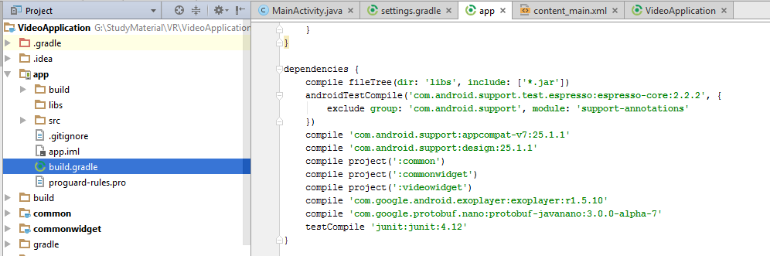
First Cardboard App: 360 Video Viewer
Now open the app modules build.gradle file and make following changes:

Slide 15
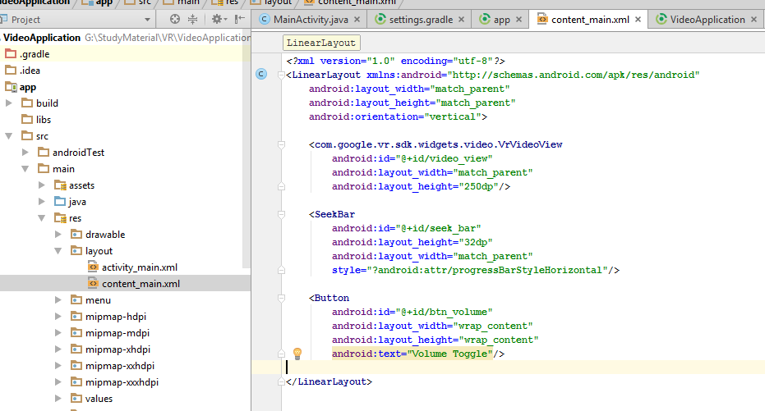
First Cardboard App: 360 Video Viewer
At this point, we have added all the necessary dependencies which are necessary for creating 360 video viewer.
Now we will create the layout file.
This component renders the
video for Cardboard.

Slide 16
First Cardboard App: 360 Video Viewer
After creating layout now we will add Java code for actions and loading the video from assests.
Open the tutorial downloaded from the spread sheet and copy the code of MainActivity.java to your Activity file.
This code is complete code which consists of following features:
Code snippets for loading video in background
Code snippets for updating seekbar based on timeframes
Code snippets for handling volume and start/pause operations
Code snippets for handling state changes ( Rotation of Device)

Slide 17
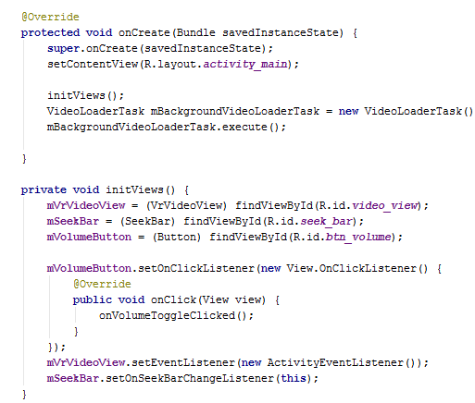
First Cardboard App: 360 Video Viewer
Code snippet for initializing the views

Slide 18
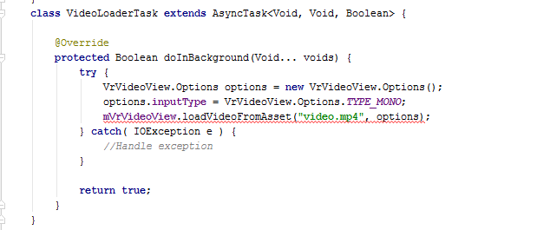
First Cardboard App: 360 Video Viewer
Code snippet for loading video in background

Slide 19
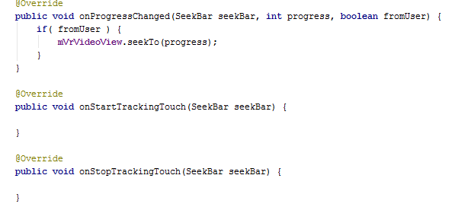
First Cardboard App: 360 Video Viewer
Code snippet for updating the seekbar based on timeframes of video

Slide 20
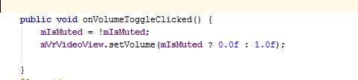
First Cardboard App: 360 Video Viewer
Code snippet for mute and unmute the video

Slide 21
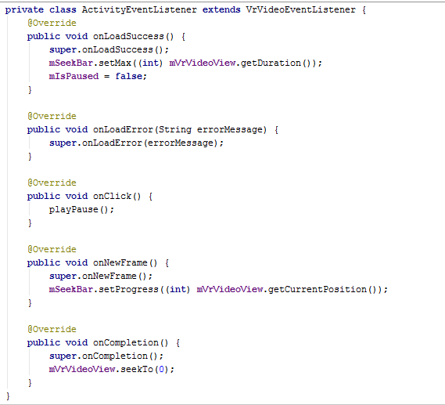
First Cardboard App: 360 Video Viewer
Code snippet for EventListener of VRViewer

Slide 22
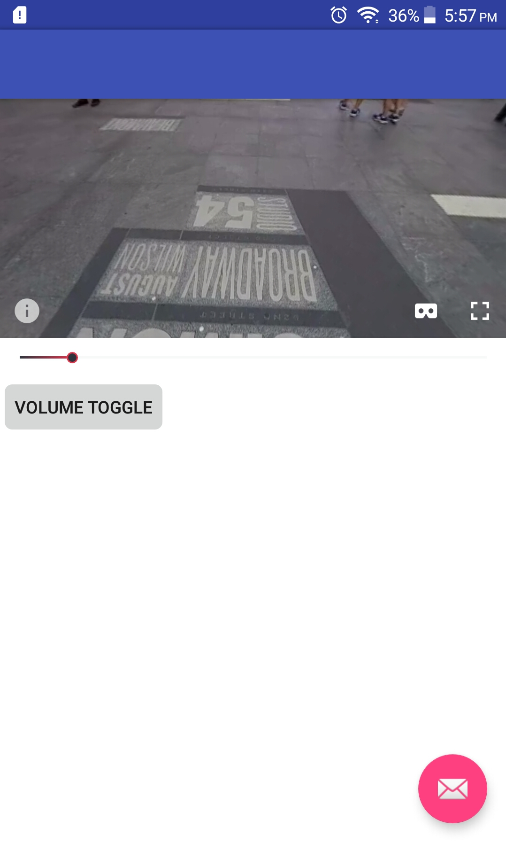
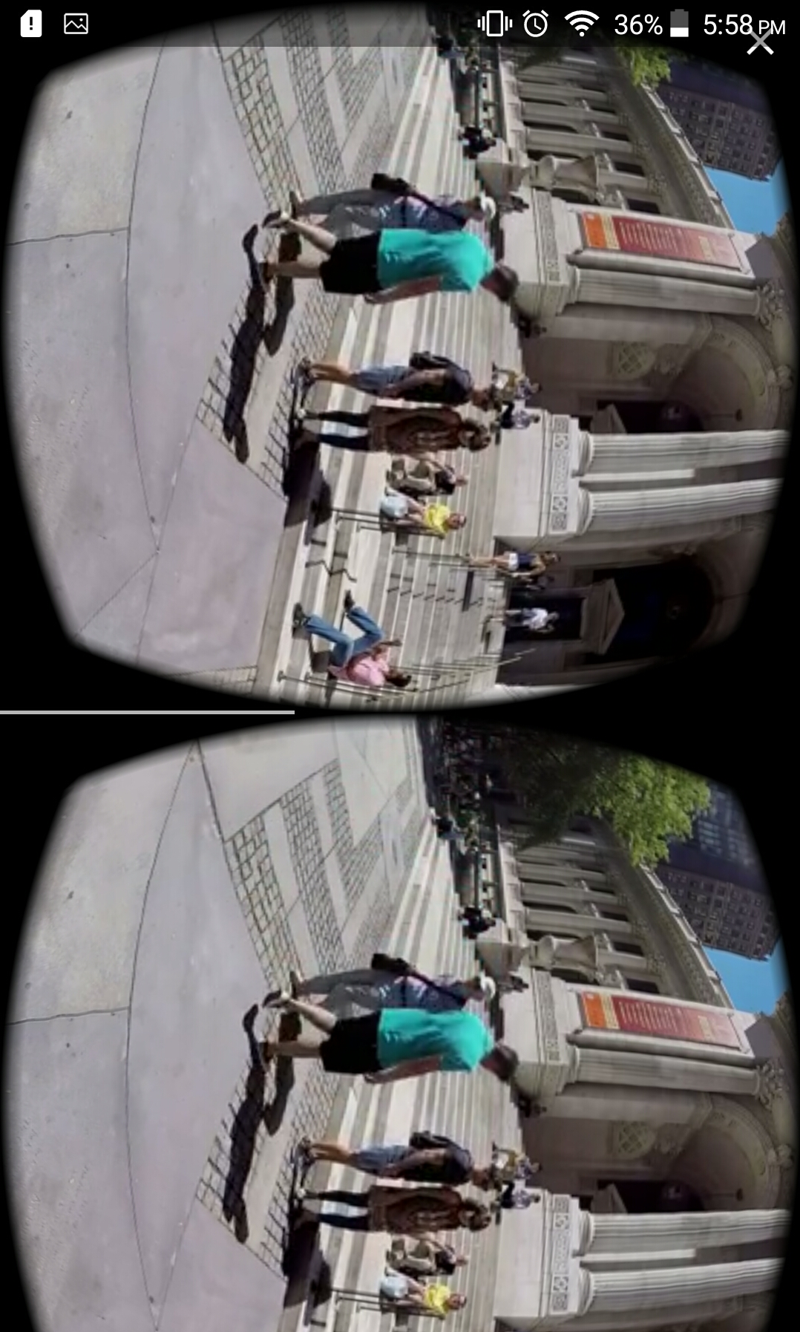
First Cardboard App: 360 Video Viewer
Kudos….. Your 360 video viewer is ready
Connect your android device and run the application
Screenshots of Application

Slide 23
Thanks

